Slide 1

Data Scraping and Analysis with Python

Slide 2

Introduction to Web Scraping
Web scraping is the process of automatically extracting data from websites.
It involves fetching a webpage's content and parsing it to retrieve specific information, such as tables, images, links, and other elements.
The goal of web scraping is to turn unstructured web data (HTML) into structured data (CSV, JSON, etc.).
Types
Static Web Scraping: Extracts data from web pages with fixed content. Typically involves scraping HTML content.
Dynamic Web Scraping: Extracts data from pages that use JavaScript (like single-page applications), often requiring the use of browser automation tools like Selenium.

Slide 3

Tools and Libraries for Web Scraping
Requests: A simple HTTP library to send requests and get content from websites.
BeautifulSoup: A Python library used for parsing HTML and extracting useful data.
Scrapy: A framework that allows for more complex, large-scale web scraping with built-in features like handling multiple pages and exporting data.
Selenium: A browser automation tool used for scraping data from websites that rely heavily on JavaScript.

Slide 4
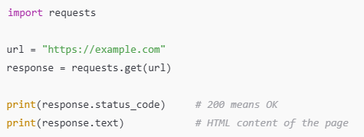
Requests
It is a simple and elegant HTTP library for Python.
It allows you to send HTTP/HTTPS requests to a web server and receive the response, such as HTML pages or JSON data.
Used to fetch content of web page that we want to scrap.

Slide 5
BeautifulSoup
It is a Python library for parsing HTML or XML documents.
It creates a parse tree from the HTML content, making it easy to search and extract specific elements (like text, tables, links, etc.).
USES
Web pages are made up of messy HTML.
BeautifulSoup makes it easy to navigate and extract specific elements using tags, classes, IDs, and CSS selectors.

Slide 6
Sample Example
import requests
from bs4 import BeautifulSoup
url = 'https://example.com'
response = requests.get(url)
soup = BeautifulSoup(response.text, 'html.parser')
# Find all paragraph tags
paragraphs = soup.find_all('p')
for p in paragraphs:
print(p.text)

Slide 7
Scrapy Architecture
Scrapy is a powerful, open-source web crawling and scraping framework written in Python.
It allows developers to write spiders (or bots) that:
Crawl websites
Extract structured data (text, images, links, tables)
Export the data into various formats (JSON, CSV, XML, or databases)
Scrapy is ideal for:
Large-scale scraping projects
Sites with pagination or multiple levels of navigation
Asynchronous scraping (faster than BeautifulSoup + requests)
Automating entire scraping pipelines (spider → parse → store)

Slide 8
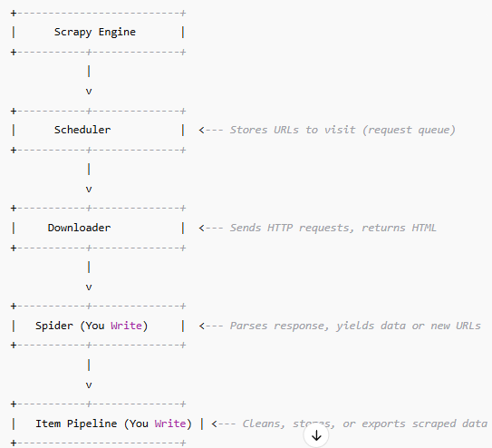
Scrapy Architecture Overview

Slide 9
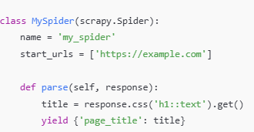
Key Components
Spider
The custom Python class you write.
Defines how to crawl a website and parse its content.
Yields items (data) or more requests (to follow more links).

Slide 10
Key Components
Downloader
Responsible for sending HTTP requests to the website.
Receives responses (HTML, JSON) and sends them back to the spider.
Scheduler
Manages the queue of URLs to be crawled.
Keeps track of what’s been crawled and what’s pending.
Scrapy Engine
The core of the Scrapy framework.
Controls the flow of data:
Sends requests to the downloader
Sends responses to the spider
Collects items and sends them to the pipeline

Slide 11
Key Components
. Item Pipeline
Optional, but commonly used.
Post-processing steps on the scraped data:
Cleaning
Validation
Storing into databases (MySQL, MongoDB)
Exporting to CSV/JSON/XML
class CleanPipeline:
def process_item(self, item, spider):
item['title'] = item['title'].strip()
return item

Slide 12
Scrapy Vs BeautifulSoup
Feature | Scrapy | BeautifulSoup + Requests
Speed | High (async, concurrent requests) | Moderate (single request at a time)
Best For | Large-scale scraping | Small or simple projects
Learning Curve | Moderate to High | Easy to start
Built-in Export | Yes (JSON, CSV, XML) | No (manual with pandas/csv)
Handles Pagination | Yes | Manual
JavaScript Pages | No (needs Splash/Selenium) | No (needs Selenium)

Slide 13
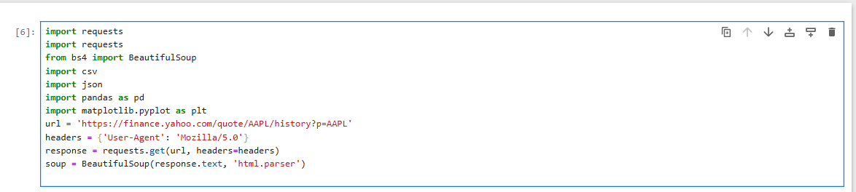

Scraping Data from Yahoo Finance
We target Yahoo Finance’s Apple stock history page.
Yahoo’s stock data is displayed in a table. Each row of that table is tr

Slide 14

Export Data to CSV and JSON
We open a CSV file for writing.
DictWriter writes the keys of our dictionary (Date, Open, etc.) as headers.
Each dictionary in stock_data becomes a row in the CSV file.

Slide 15
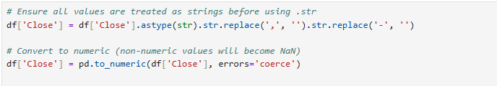
Data Cleaning and Visualization
Loads the scraped CSV data into a pandas DataFrame, which is like an Excel table in Python.
Converts the Close column to numeric (removing commas and dashes like '—’).
Converts the Date strings into actual datetime objects for proper plotting.
Removes any rows where the conversion failed (bad or missing data).

Slide 16
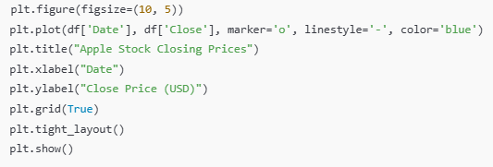
Plotting
Plots a line graph with date on the X-axis and closing price on the Y-axis.
Uses markers and gridlines for better visibility.

Slide 17
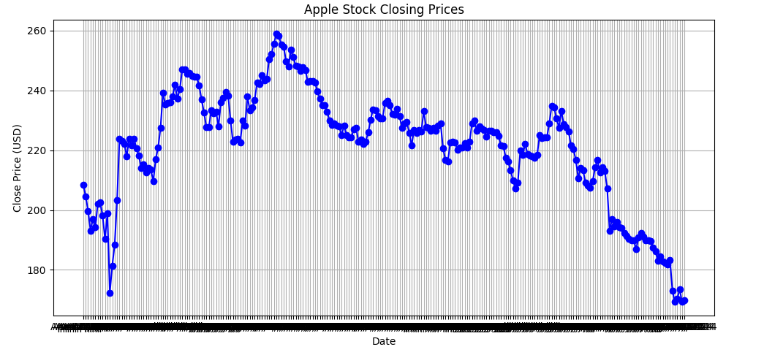
Result

Slide 18
Conclusion & Takeaways
BeautifulSoup: Simple for small jobs
Scrapy: Powerful for large-scale projects
Financial data scraping is practical
Visualization reveals trends
Collaboration improved understanding

Slide 19
References
BeautifulSoup - https://www.crummy.com/software/BeautifulSoup/
Scrapy - https://scrapy.org/
Yahoo Finance - https://finance.yahoo.com
Pandas - https://pandas.pydata.org
Matplotlib - https://matplotlib.org

